Slide 1
tensorflow-ruby
Charlie Savage

Slide 2
Who Am I?
Developer for almost 25 years
Maintain/contribute to various gems: composite-primary-keys, ruby-prof, libxml-ruby, freeimage, proj4rb, ruby-keychain, etc.
Founder of Zerista, an event platform - think LinkedIn/Facebook for conferences
Zerista was acquired by SimpleView in December 2018, I left June 30, 2019

Slide 3
Zerista – Rails Server
+----------------------+--------+--------+---------+---------+-----+-------+
| Name | Lines | LOC | Classes | Methods | M/C | LOC/M |
+----------------------+--------+--------+---------+---------+-----+-------+
| Controllers | 20534 | 16762 | 191 | 1254 | 6 | 11 |
| Helpers | 6517 | 5377 | 0 | 598 | 0 | 6 |
| Jobs | 1788 | 1425 | 71 | 104 | 1 | 11 |
| Models | 48576 | 38085 | 1358 | 4209 | 3 | 7 |
| Mailers | 611 | 475 | 7 | 44 | 6 | 8 |
| Libraries | 2532 | 1903 | 31 | 152 | 4 | 10 |
| Helper tests | 1714 | 1302 | 28 | 140 | 5 | 7 |
| Job tests | 1622 | 1191 | 27 | 86 | 3 | 11 |
| Integration tests | 5973 | 4096 | 43 | 179 | 4 | 20 |
+----------------------+--------+--------+---------+---------+-----+-------+
| Total | 89867 | 70616 | 1756 | 6766 | 3 | 8 |
+----------------------+--------+--------+---------+---------+-----+-------+

Slide 4
Learning AI/Machine Learning
Completed Udacity Stanford class
Completed Coursera ai.specialization
To really understand deep learning I wanted something to program
  Didn’t want to write throwaway code
  Didn’t want to just use a ML framework, like TensorFlow
  How about Ruby bindings for TensorFlow?

Slide 5
What is TensorFlow?
A machine learning framework – its like the Ruby of Rails of machine learning!
Tries to get rid of as much tedious, boilerplate code as possible
Expresses computations as directed acyclic graph (DAG)
  Nodes are operations with any number of inputs and outputs
  Edges are tensors which flow between nodes
Executes graphs across any number or machines and types of chips (CPU, GPU, TPU, etc).

Slide 6
TensorFlow Scope
Very large project!
  1,136,688 lines of C++ code
  743,621 lines of Python code
  2,000 endpoints
Tensor Flow 2
  Removal of APIs
  Switch to eager execution mode (versus graph)
  Use of gradient tape versus autodiff
  Promotion of Keras as recommended high level api

Slide 7
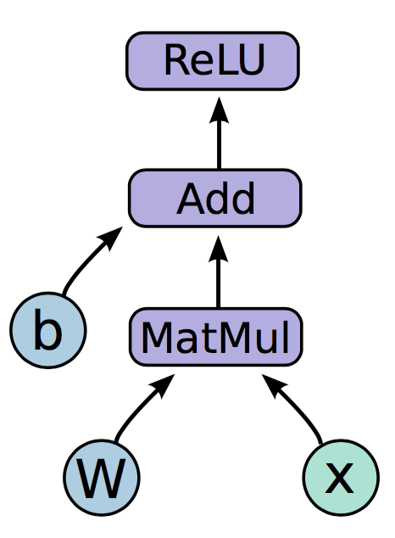
Graph Mode
In TensorFlow 1.x you build a directed graph
Session#run executes the graph
TensorFlow can distribute execution across multiple machines
TensorFlow supports CPUs, GPUs, TPUs, etc.
This is a *weird* way of programming (logging, debugging, control flow are hard)
No Ruby (or Python code) involved
Graphs get *complex*

Slide 8
Eager Mode
New default with TensorFlow 2
This works like normal programming – operations are executed immediately
Much easier to debug, log, and no need for inserting control flow operations into a graph
Makes extensive use of hosting language (Python)
Much slower (Python isn’t fast)

Slide 9
Neural Networks

Slide 10
Ruby and TensorFlow
tensor_stream – Port of TensorFlow to Ruby. Full support for training and running models, but is not actually TensorFlow
tensorflow.rb – Sponsored by scriruby. Provides minium functionality, last development August 2018
tensorflow – Gem started in September. Also provides minimum functionality. Was starting point.

Slide 11
tensorflow-ruby
Started work in early October
Read a lot of source code!
Porting Python code to Ruby
Gem is about 15,000 lines of Ruby code
Can now train a neural network!

Slide 12
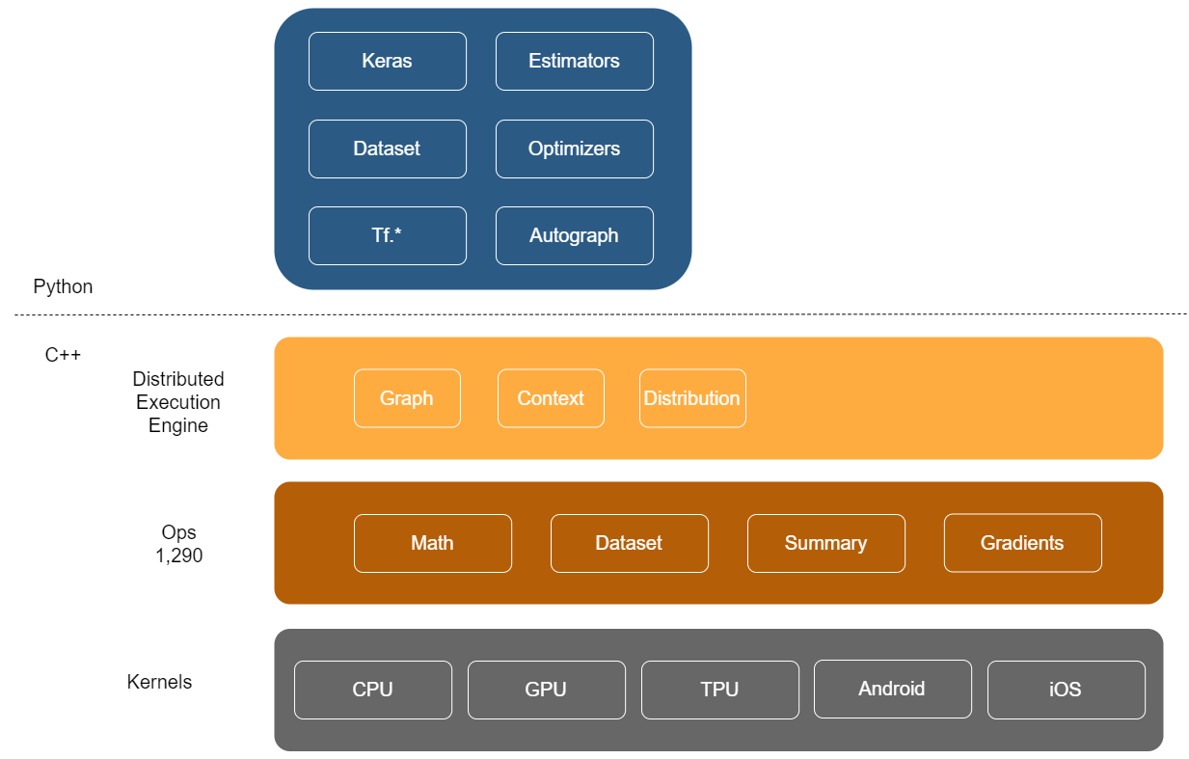

Slide 13
Write a TensorFlow Language1
https://github.com/tensorflow/docs/blob/master/site/en/r1/guide/extend/bindings.md
Graph mode
  Run predefined graphs
  Create and modify graphs
  Gradients (AKA automatic differentiation)
  Sessions
  Control Flow

Slide 14
Write a TensorFlow Language 2
Eager Mode
  Functions
  Integration with host languate
  Gradient Tape

Slide 15
Write a TensorFlow Language 3
Datasets
Keras
Logging for tensorboard

Slide 16
Start Simple – Linear Regression
Not really that simple, requires ability to:
  Create and build graphs
  Access to TensorFlow ops
  Execute graphs
  Backpropagation using AutoDiff
  Integration with TensorBoard
Took about 3 weeks to accomplish

Slide 17
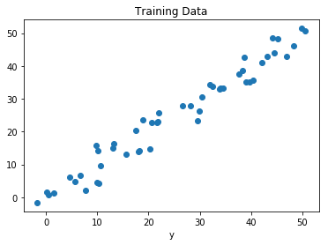
Linear Regression – Example Data

Slide 18
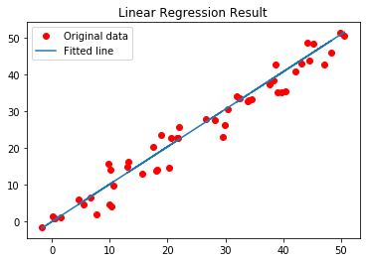

Linear Regression – How to Solve

Slide 19
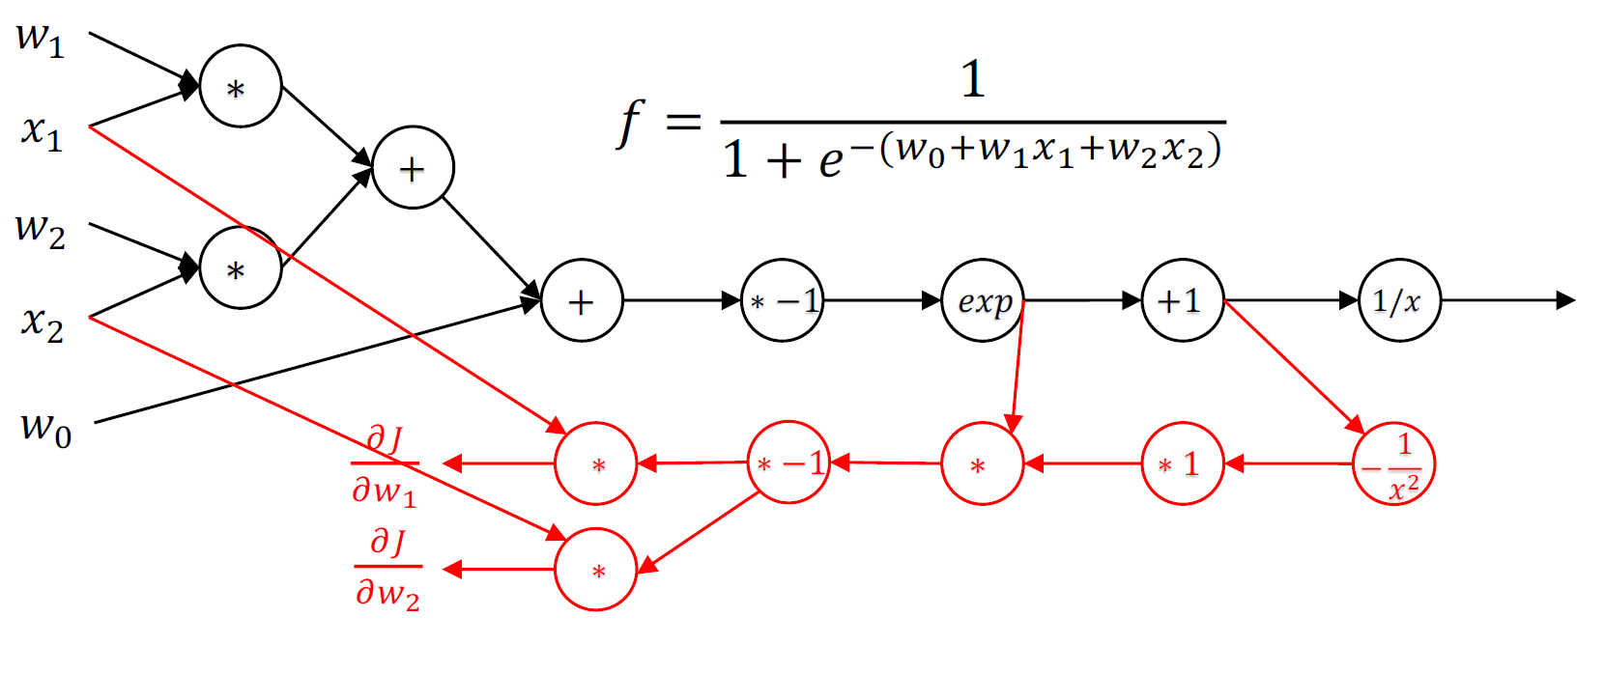
Backpropagation

Slide 20
Linear Regression in Ruby

Slide 21
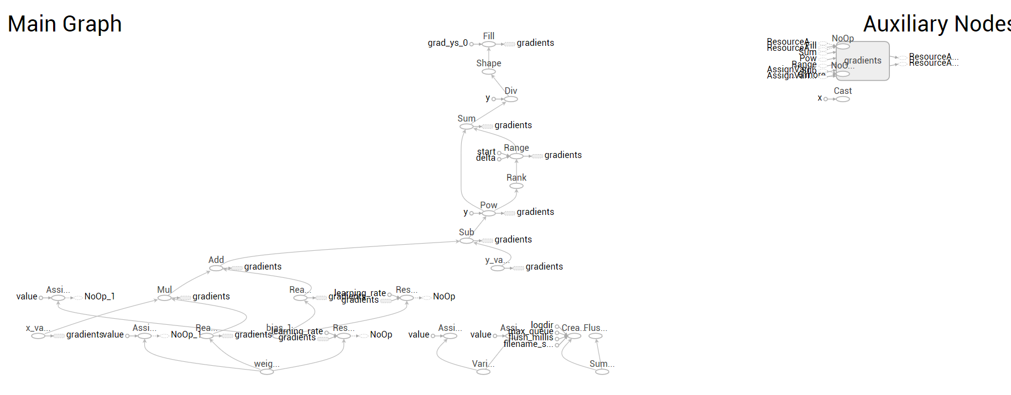
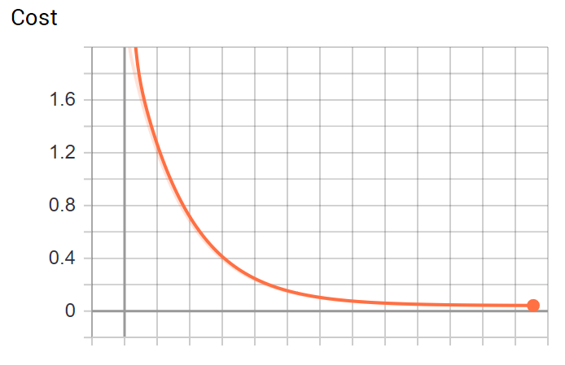
TensorBoard Visualization

Slide 22
MNIST – Hello World of Machine Learning
Next step is implementing MNIST
But lots more challenges
  Porting Python code to Ruby
  Want to support Dataset API
  Python Context Managers (with …: )
  Python decorators (@tf.function)
  Function tracing and Autograph
Took about 3 more weeks to accomplish

Slide 23
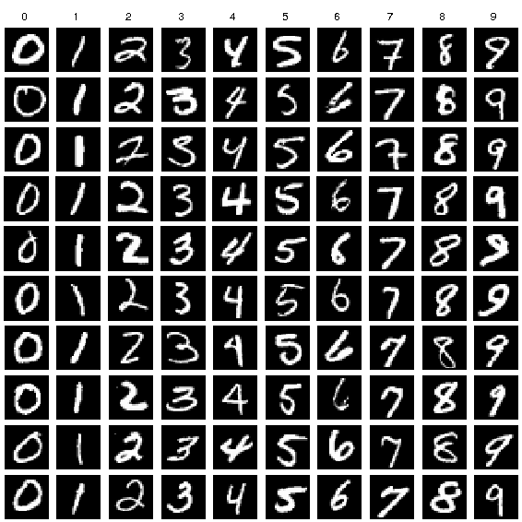
MNIST Data

Slide 24
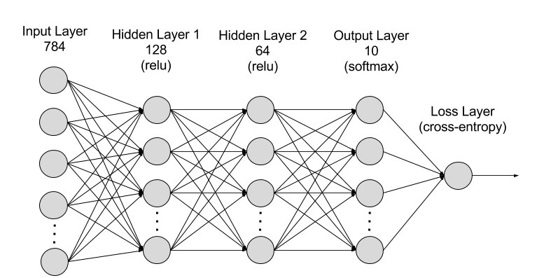
MNIST – Simple 3 Layer Neural Network

Slide 25
Datasets
Functional like API for loading data
Load data from CSV or Binary format
Provides Batch, Repeat, Map, Shuffle, Filter

Slide 26
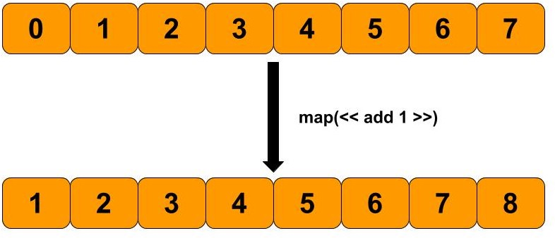
MapDataset

Slide 27
Version Using Lower Level API
map_function = Graph::Graph.new.as_default do |func_graph|
x = Tensorflow.placeholder(:int32, name: "x")
one = Tensorflow.constant(1)
plus_one = Tensorflow::Math.add(x, one)
func_graph.to_function('map_function', nil, [x], [plus_one])
end
Graph.current.add_function(map_function)
components = [[1, 2, 3]]
dataset = TensorDataset.new(components)
map_dataset = MapDataset.new(dataset, map_function)
result = self.evaluate(map_dataset)

Slide 28
Version Using Ruby Function
@tf.function(([[:int32]]))
def map_function(original)
original + 1
end
components = [[1, 2, 3]]
dataset = TensorDataset.new(components)
map_dataset = MapDataset.new(dataset, map_function)
result = self.evaluate(map_dataset)

Slide 29
Faking Decorators
In Python, @ signifies a “decorator” which is a function that wraps the function that immediately follows it. TensorFlow uses @tf.function to compile a Python function into a graph
Goal is to match the Python syntax in Ruby and of course in Ruby @ represents an instance variable
To fake this, when including the Tensorflow::Decorator module @tf is set to the module itself and “function” is a module method (def self.function).
The function method creates a new Tensorflow::Function instance which calls FunctionDef which uses alias method to wrap the original method.

Slide 30
Tracing Functions
When map_function is executed, it calls the wrapper method which in turns calls the wrapped method and builds a computation graph
map_dataset = MapDataset.new(dataset, map_function)
This approach is known as method tracing – the method is actually executed to build the graph
Python has a comprehensive method tracing implementation – since the trace could depend on the inputs, for each function call it caches the results based on the inputs

Slide 31
Parsing Functions
TensorFlow 2 has a feature called Autograph
In contrast to function tracing, Autograph parses the Python code into an abstract syntax tree and then builds the computation graph from that
This is doable in Ruby, but it is outside the scope of my implementation. So as a Ruby programmer, you have to be careful about how you write methods that turn into graphs!
Note Google is modifying the Swift compiler to do this as part of the compilation phase (Swift uses LLVM, this would be another step in the compilation pipeline)

Slide 32
Context Managers (With Statement)
Notice this code:
The placeholder does not specify what graph it uses, but ends up in the func_graph
In Python, this is done using the construct “with Graph.as_default:”
Behind the scenes, this is a context manager and provides a enter and exit method which sets the current graph
Modeled as a block in Ruby
map_function = Graph::Graph.new.as_default do |func_graph|
x = Tensorflow.placeholder(:int32, name: "x")
…
end

Slide 33
MNIST - Ruby

Slide 34
Next Steps
Training using Eager Mode – requires implementing Gradient Tape
  Gradient tape C++ code is not exposed by the C API
  Significant functionality is in Python
Port Keras implementation to Ruby (271 files, 133,080 lines of code)
Fill in lots of missing APIs

